Slide 1
Helping Hand: Sprint 1
Piyusha Dongre, Chelsea Lau, Ysatis Tagle

Slide 2
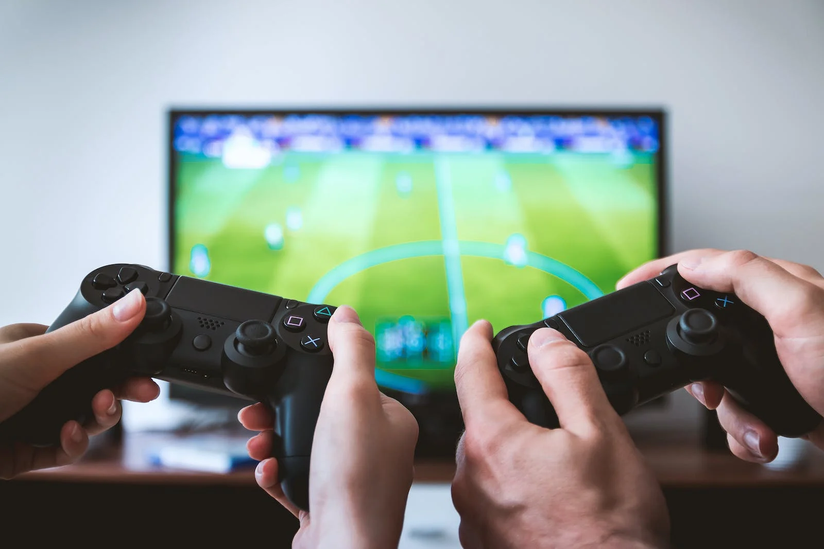
Product Mission
Goal : Video game assistive prosthetics to help the user play video games
Motive:
Individuals with limb loss/ limb difference have to adapt the controllers themselves
Benefits to the user:
Gaming can allow people who are disabled to learn new skills as well as provide therapeutic benefits
Allow them to socialise and boost their self-esteem
Notes:
https://www.pexels.com/search/video%20games/
Piyusha

Slide 3
Users
People with partial or total loss of hand mobility
People with hand muscle weakness or lack of muscle control
People with temporary hand injuries
Notes:
Piyusha

Slide 4
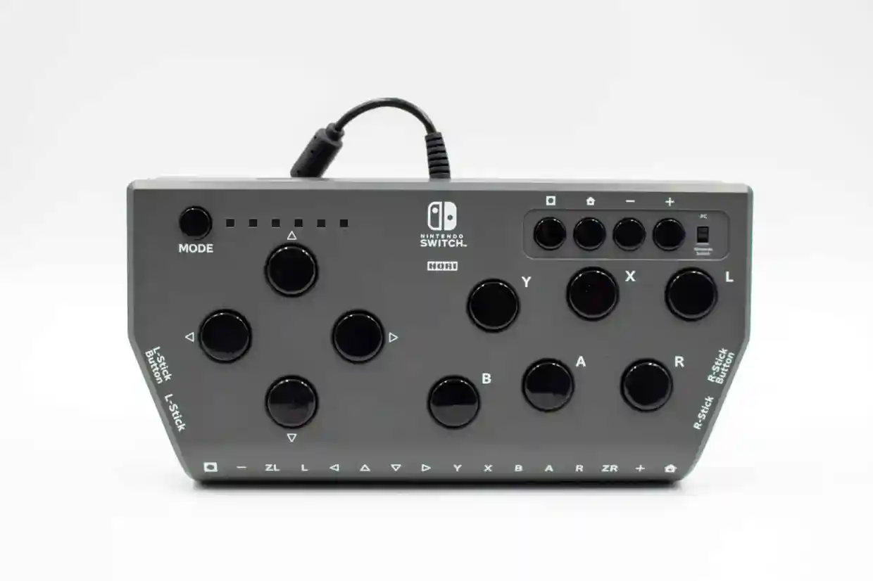
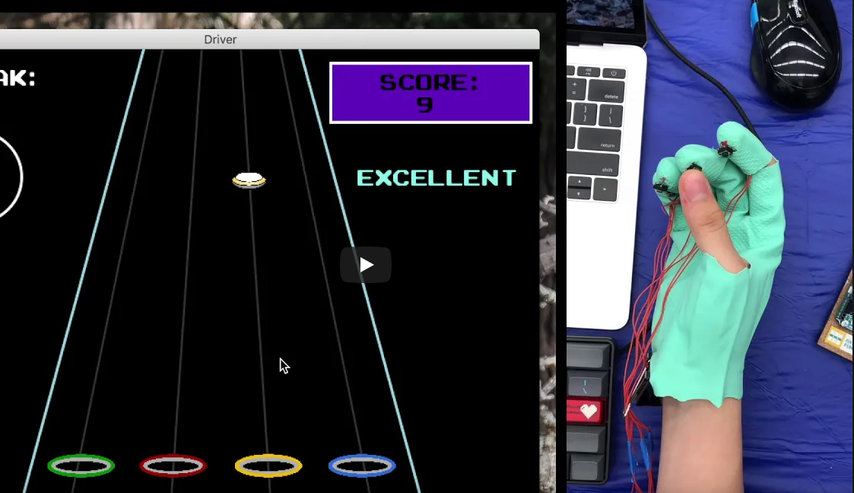
Gaming Innovations
Ablegamers - Hori Flex
Top adaptations:
Inputs
Controls
Presentation
Output
Less common:
Performance, training, progress, social, moderation
Infinity Gauntlet
Notes:
Ysatis
Currently, users use one or more of these adaptions, however, where our product comes in is….
https://www-users.cs.york.ac.uk/~pcairns/pubs/Cairns_IJHCS19.pdf
https://ablegamers.org/knowledge-base/hori-flex/
https://devpost.com/software/infinity-gauntlet-2-0

Slide 5
User Stories
“I want to play games with other people”
“I love gaming! But there isn’t a lot of games that I can play.”
“I want to be able to use a controller”
“I don’t want to use cheats”
“I want to feel equal”
“I want to be able to play, but the game I like doesn’t work well with __screen readers__”
“I don’t want to feel limited to play XYZ when my friends play ZYX”
Notes:
ysatis

Slide 6
Literature Review: Design Decisions
Movement:
Actuators: Springs, pneumatics, hydraulics, motors
Manipulation:
Controller interaction
Control:
Microcontroller
Software
Control scheme for robotics
Libraries for input processing
Power supply
Sensors:
User input
Game detection
Notes:
Chelsea?
So, in our literature review, we looked into a lot of open source projects. Because of the vastness of robotics, there is a lot of of design decisions the team has to make when it comes to our project. For this first sprint, we focused on researching user input, and we identified a few common solutions.
On Control Scheme - sequential control (vs simultaneous control) is most popular in prostheses…
Control Schemes - on-off control, proportional control, direct control, FSM control, pattern-recognition based control, posture control, regression control
https://www.ncbi.nlm.nih.gov/pmc/articles/PMC4968852/
https://www.mdpi.com/2218-6581/10/1/40/htm
https://www.galileo.org/robotics/design.html

Slide 7
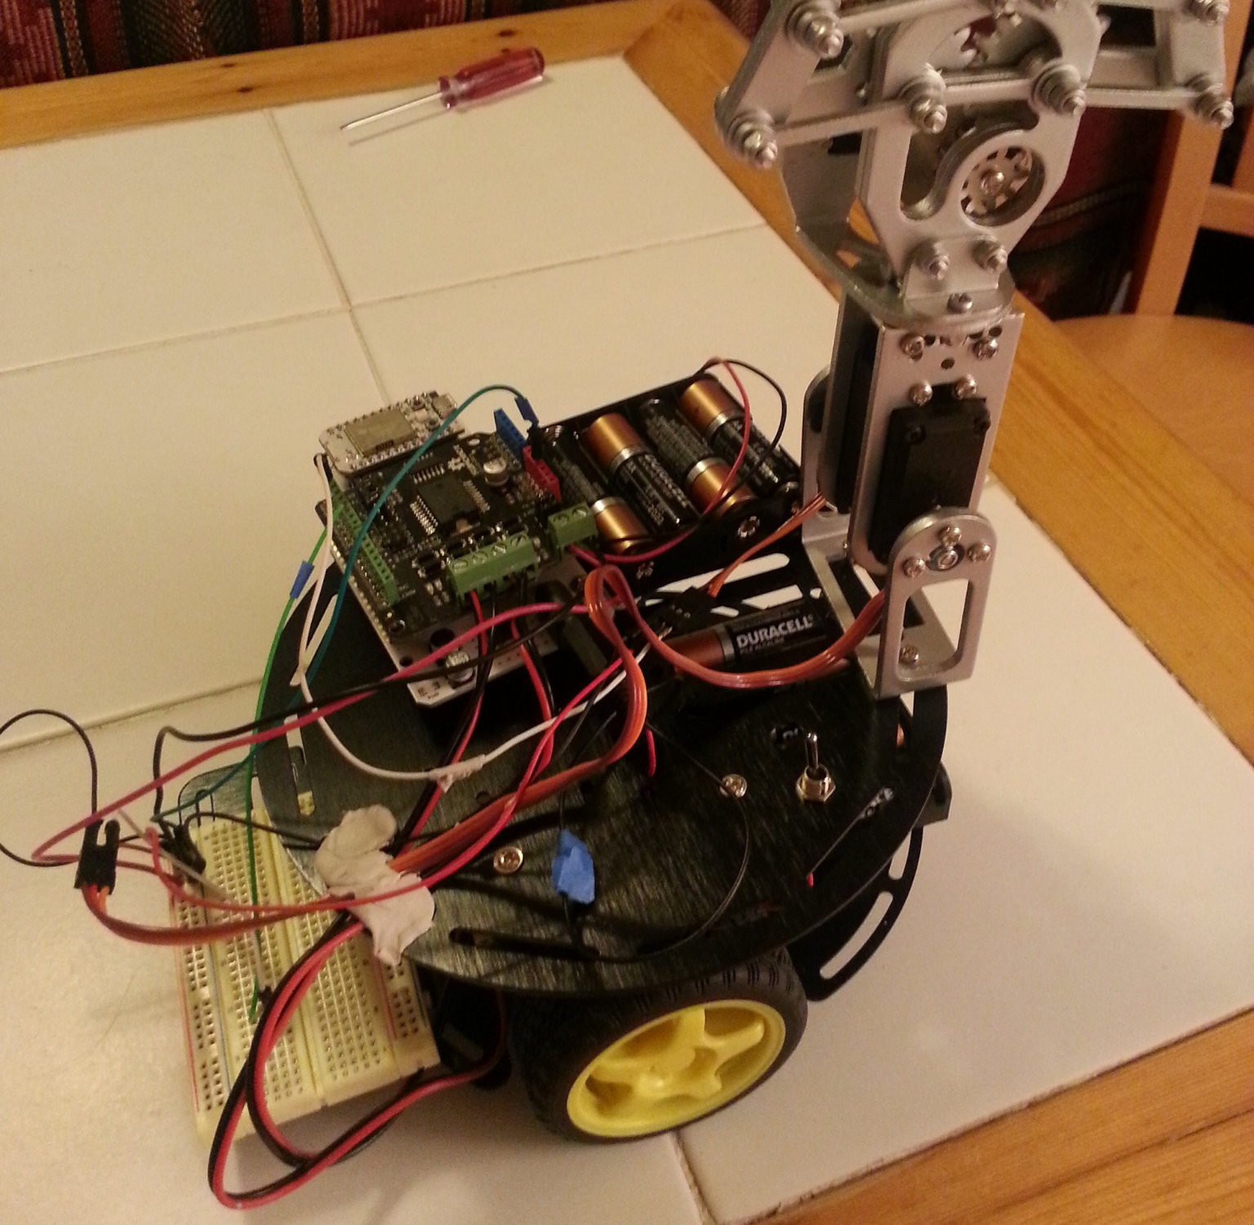
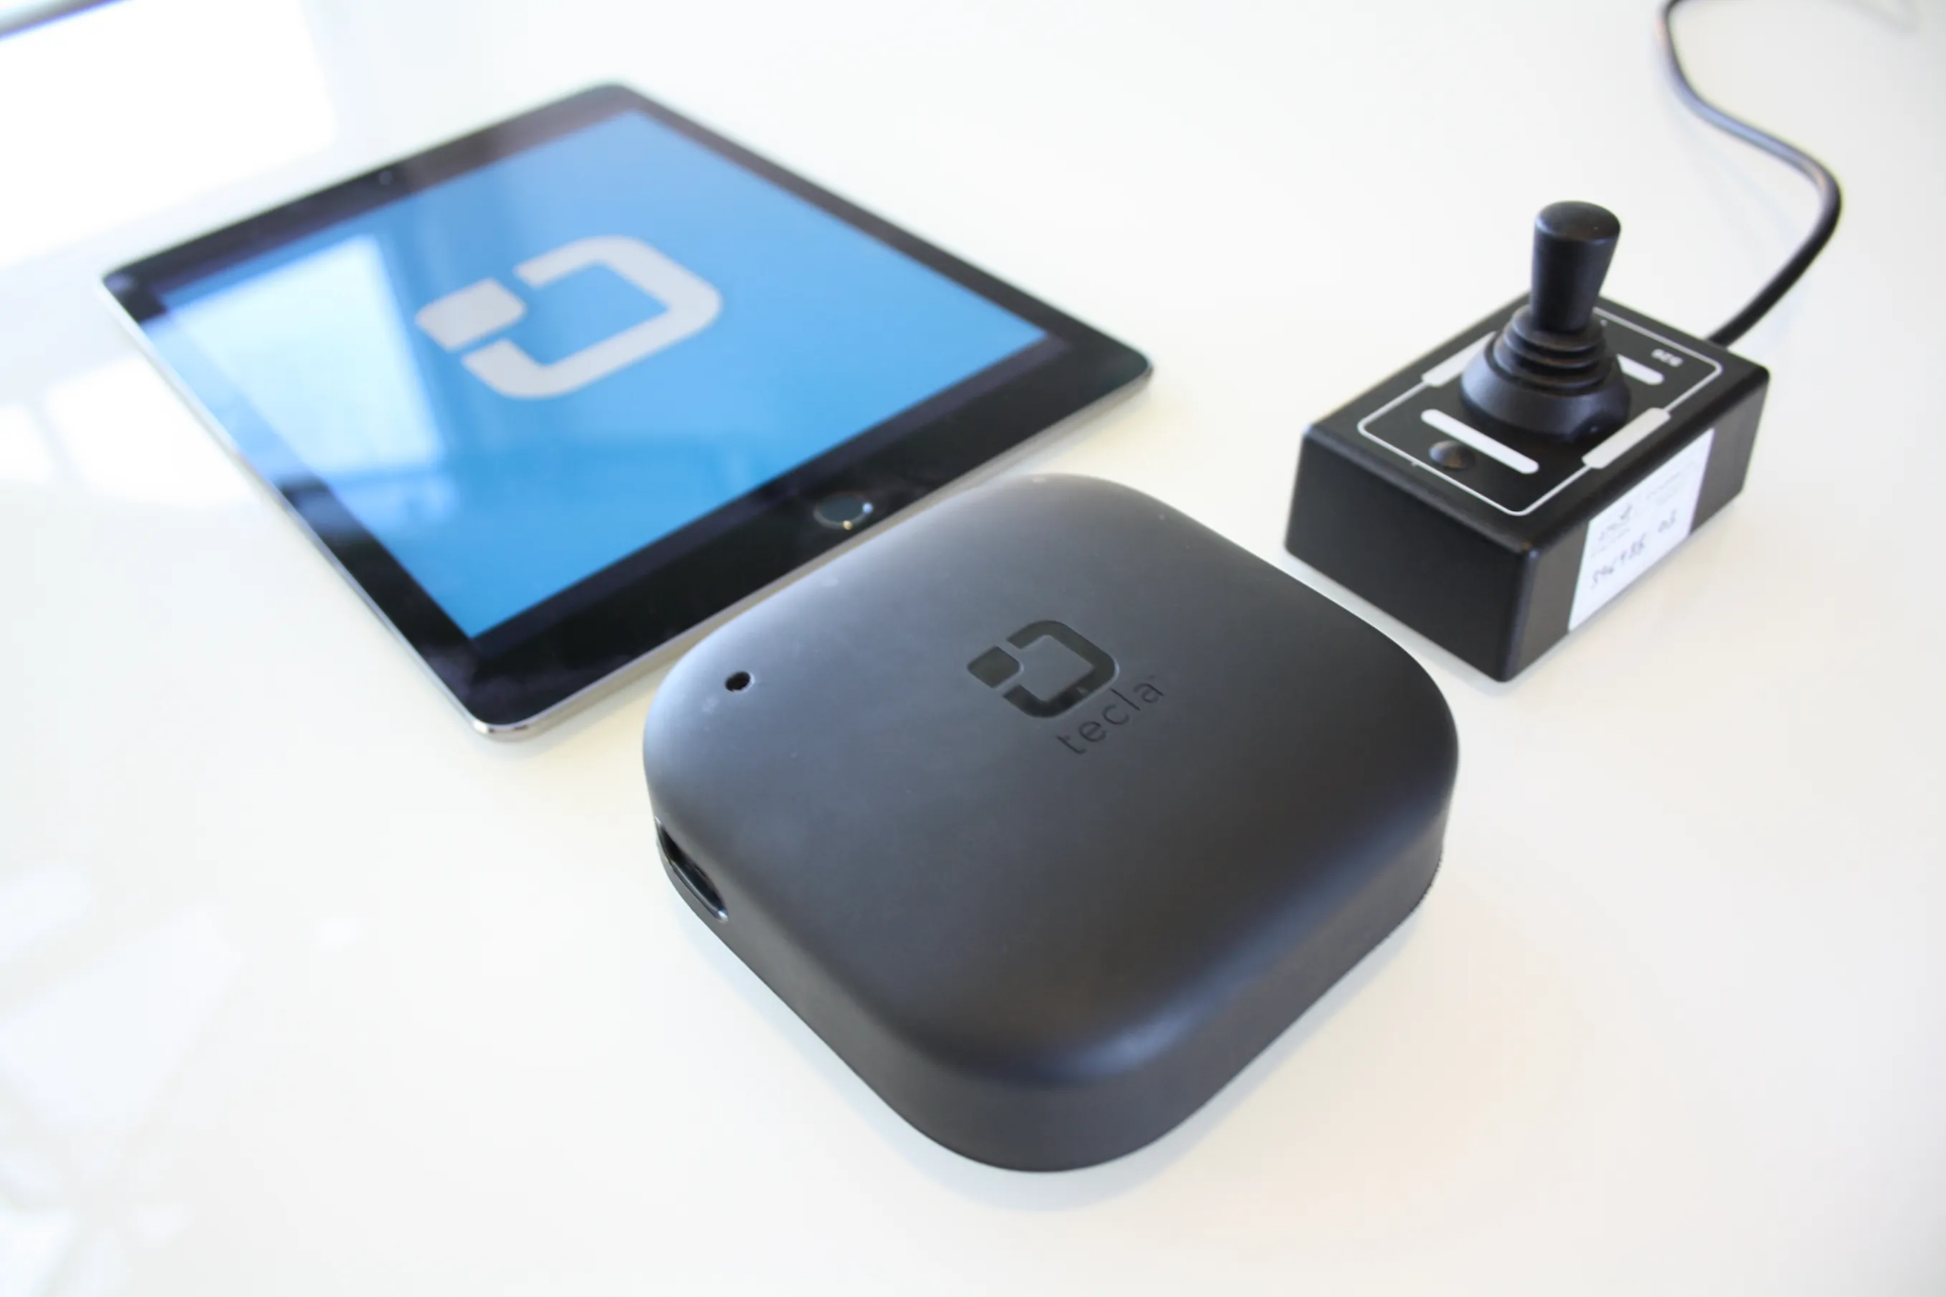
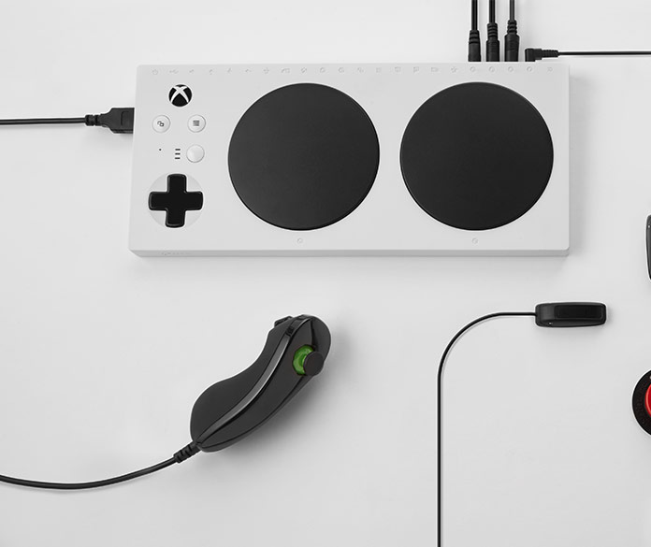
User Input: Direct Signal
GrabbyBot
Tecla-E
Xbox Adaptive Controller
The user must command the system via motion, buttons, or external commands.
Notes:
Ysatis
https://hackaday.io/project/193-grabby-bot
https://gettecla.com/
https://www.xbox.com/en-US/accessories/controllers/xbox-adaptive-controller

Slide 8
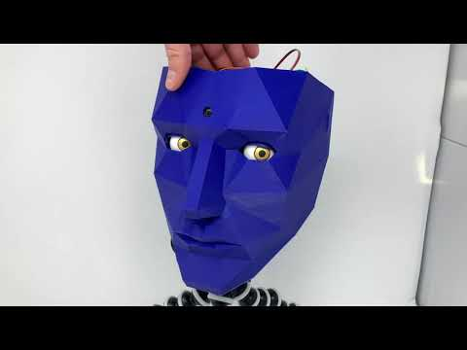
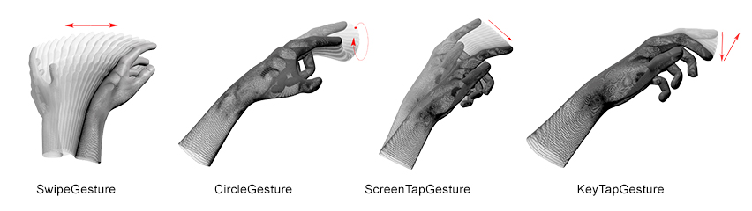
User Input: External
Processing
Watchman
Uses external libraries to understand sensor input
Voice commands
Python Speech Recognition
Visual images
Google Vision Hat
Motion
Leap Motion Processing
Leap Processing
Notes:
Ysatis
https://vimeo.com/179539387
https://github.com/abhishekyana/Robotic-hand
https://grahamjessup.com/watchman/

Slide 9
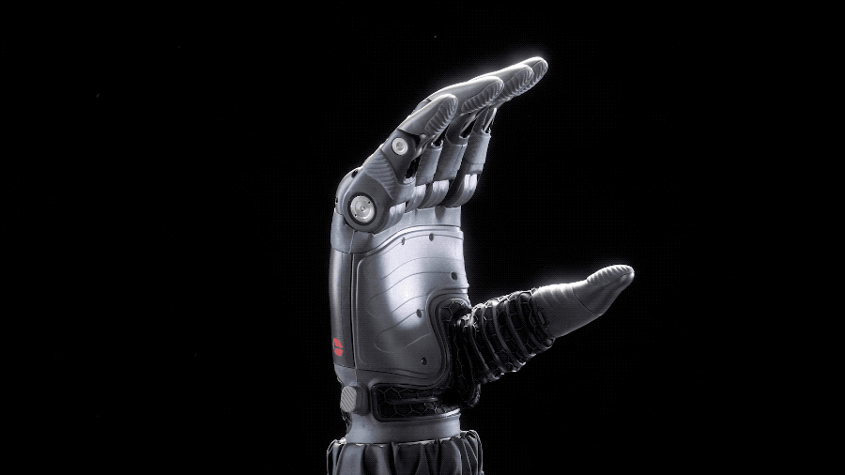
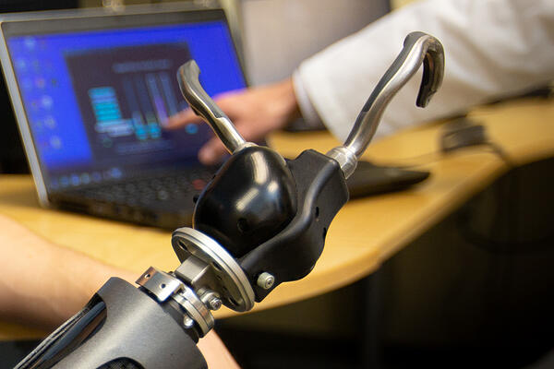
User Input: Myoelectric
Myoelectric Prostheses
Powered by motors and batteries
Controlled by input from electrical signals generated by muscles in residual limb
Taska Hand, bebionic, i-limb, Michelangelo Hand
Myoelectric Hooks
Provides fine, precision tip pinch
High pinch strength
Durable and waterproof
ETD, ETD2, AxonHook
Notes:
Chelsea
https://www.armdynamics.com/upper-limb-library/introduction-to-myoelectric-prostheses
https://mcopro.com/prosthetics/technology/ilimb-quantum/
Taska Hand and ETD shown
Typically advanced prosthetic devices use myoelectric control to read the small voltages given off by a user's muscles, called electromyography (or EMG) signals. From these voltages we can tell what muscles around the users forearm are flexed and can then determine what grip they are using.
https://www.instructables.com/Tact-Low-cost-Advanced-Prosthetic-Hand/#:~:text=Step%205%3A%20Controlling%20the%20Hand,what%20grip%20they%20are%20using.

Slide 10
Technologies to evaluate and reason for choosing them
Type | Advantages | Disadvantages
Myoelectric Prostheses | Less effort from user end More freedom of movement than body-powered | Batteries and motors are heavy Harder to waterproof Expensive Restricted to users capabilities
Direct Signal | Easier to implement Cheaper for user/DIY solutions | Requires internet connection Restricted to user’s capabilities (accessibility)
External Library Processing | More robust due to open source development Hands off for user | Limited to library for sensing capabilities
Notes:
Ysatis and Chelsea
Using MES (Myoelectrical Signals) also usually involves using electrodes, which on compromised or fragile skin can be finicky
https://www.mdpi.com/2218-6581/10/1/40/htm (Ysatis)
https://arxiv.org/ftp/arxiv/papers/2112/2112.13192.pdf

Slide 11
MVP and MVP User Stories
MVP - Minimum Viable Product
Provides at least rudimentary control interface for someone with limited hand mobility/fine motor skills
Moves joystick/pushes a button on video game controller
MVP User Story:
As a user, I want to be able to utilize the prosthetic so that I can use basic controls on a video game controller.
Notes:
Chelsea

Slide 12
Next Sprint Goals
Decide on user input hardware and method
Research into actuators
Begin brainstorming testing standards (controller type/game type)
Identify relevant open source software to use
Notes:
Piyusha?

